Slide 2
Avanade DevOps Practice
Sept-2017

Slide 3
Agenda
Understand DevOps
DevOps Offering & Approach
Capability
Credentials

Slide 4












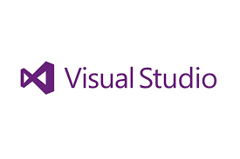

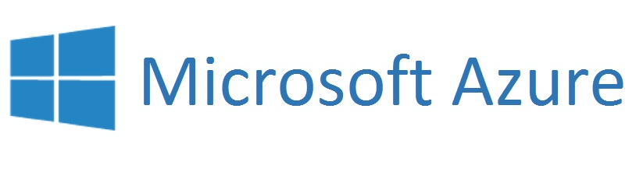
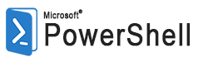










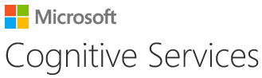





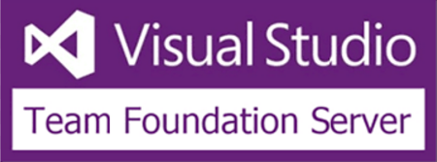
DevOps @Avanade
DevOps Case Studies
Key Skills
@ Scale
Experience
Delivery Models
121+
24x5 support
Managed delivery / Capacity services
ME Studio (in Bengaluru)
Complete offshore capability
946+
Clients – DevOps Implementation
DevOps
Professionals
127+
Offerings
Industrialization
ALM/DevOps Practioners
(Primary Skill)
DevOps Assessment
Implementation Guidance
Process Consultation
MEP Advisory & Services
DevOps Insight
DevOps Handbook
875+
10+
accelerators
DevOps Academy Trained
Key Skills/Tools
121+
Clients -
DevOps Implementation
AMP
GIT

Slide 5
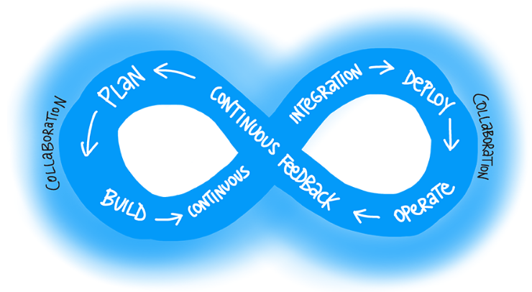
Understand DevOps

Slide 6
“Marriage of Speed & Stability…” “The union of people, process, and products to enable continuous delivery of value to our end users.”
What is DevOps?

Slide 7
DevOps – What does it mean ?
DevOps
People
Process
Tools
What it is ?
Anti-Patterns
Our Definition
Being Aware & Acknowledge concerns that Dev & Ops teams face
Emphasize on communication, collaboration and integration between Dev & Ops teams
Better co-ordination of People, Products & Processes
Effective Orchestration to accelerate delivery,
Optimize Resources, Improve Availability, Increase Application Quality
It needs a cultural change
Just Dev or Ops
A person
A product
Just automation
DevOps means Developers managing Production
Continuous service delivery and continuous feedback process that enables enterprises to respond faster to the service change needs by being agile thus shortening the cycles between application development (Dev) and operationalizing (Ops) the new service for the business.
Business Benefits
More Deliverables
Lower Maintenance Window
Faster Deliveries
Less Production Issues
Successful Deployments
Environment Stability
Measure
DSR
Ticket Volume
MTTC
MTTR
CHV
MTTD
Develop
Test
Release & Deploy
Monitor & Feedback
Plan
Map Business Benefit
to DevOps KPI
Guidance
To Improve Each KPI

Slide 8
Avanade’s Seven Guiding Principles to DevOps
DevOps
People
Process
Tools
1. Cohesive Teams
4. Automate Everything
7. Deliver Small Increments
2. Test Early & Often
5. Strong Source Control
3. Improve Continuously
6. Experiment Frequently

Slide 9

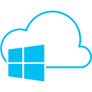
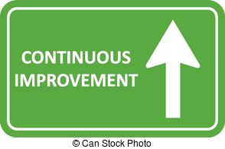










DevOps Roadmap…
Reduce Cycle time
Increase Throughput
Speed to Market
Automation
Cloud
Normal
Business
& IT Leadership
Express
Product Backlog
Quality Management
Release Management
Service Management
On-premise
Continuous Feedback
AM -
Live site monitoring
Service Requests
Proactive maintenance
Contribute to Product Backlog
Notes:
When we first engaged with this client, the customer told us that they need Jira in order to get agile and GitHub in order to develop code faster. Like many other companies, people in the delivery focussed role though their problem was lack of tooling. DevOps is however not a tool that you can buy and sprinkle to make your organization DevOps …
DevOps is
A culture
About Collaboration
A practice evolved in (lean) start-ups
DevOps is not
A tool, or set of tools
A designated (DevOp) role or person
An operations team renamed the “DevOps team”
A development team granted admin access
A developer power grab

Slide 10
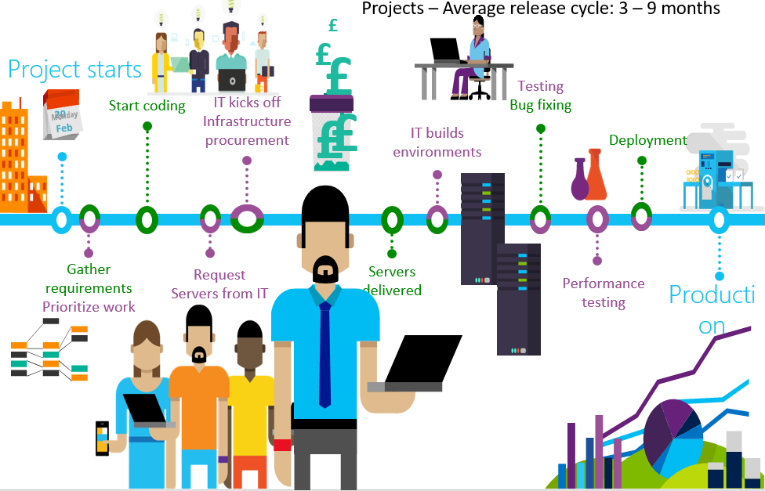
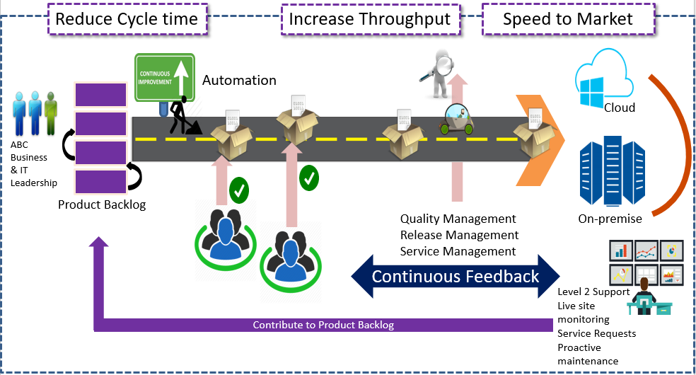
DevOps Journey
Long running release cycles & QA testing process
Unstable and poor code quality
Lack of standard processes & desired skills
Productivity loss due to unstable environments
Delaying infrastructure provisioning requests
Potential performance & security issues
Potential application availability issues
Before DevOps
Shorter & frequent releases
Ensuring code quality & security compliance checks
Short iterative development cycle improving code quality
Shorter QA & testing cycle with lower defect rates
Rapid & Continuous delivery with fast feedback, better team productivity
Faster consistent environment provisioning
Zero downtime during the continuous deployment
After DevOps

Slide 11
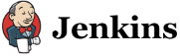













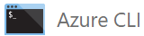









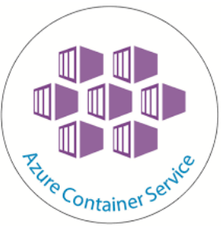









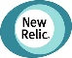








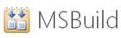



















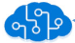



DevOps Tools Guidance - Microsoft Ecosystem
Plan
Analysis
Collaboration
Dev
Continuous Integration
Feedback
Release
Office
Release & Deployment
Octopus Deploy
CI
ALM Maturity Framework
VSTS RM
TFS RM
WIX Toolset
OneDrive
Application Insight
Azure DevTest Lab
Environment
Config. Mgmt.
PowerShell DSC
ALM Maturity Framework
Azure Resource Groups
Visual Studio
Container
Dev
Docker
Docker Swarm
Monitor
GIT
Monitor & Operations
Application Insight
AppDynamics
NewRelic
SCM & Repository
Chef
SCOM
IntelliTrace
Azure Diagnostics
& Logging
TFVC
Docker Hub
The Orange Ticket Tracker
Azure OMS
Test
IntelliTrace
VS Unit Test
Azure Log
Analytics
Build
VS Code Analysis
Analytics
App Insight
Analytics
Code Quality
VS Code Metrics
VS Clone
Azure LUIS

Slide 12
DevOps Offerings

Slide 13

Offering: DevOps Insight/Assessment
DevOps
People
Process
Tools
Input
Understand Project Ecosystem
Understand Need
Technology stack
Delivery Methodology
Understanding on Delivery Cycle
Current Tools Usage
Processes Followed
Team Knowledge
Execution and Deployment Arch.
Understand Business Needs
Tools ** Integration & Configuration
Automation
Process Changes
Team Training,
Process to Track KPI
KPI Review
Implementation Review
New Implementation Needs
Additional Training Needs
Activity
Feasibility
Assessment
Survey
1-2 Weeks *
2-5 weeks *
Offline
Detailed
Assessment
Execution
Continuous Improvement
Output
Focus Area
Need of SME(s)
Potential Schedule
Access requirements
Engagement Model
Effort and cost Estimation
Scope Document
Process observation and changes with recommendation
Implementation List with plan
Current Maturity
Execution Report
Improved Maturity
Continuous Improvement Plan
Improved Maturity
Improved KPI
Execution Report
* Ballpark Numbers ** Required Tooling License to be provided by Client

Slide 14
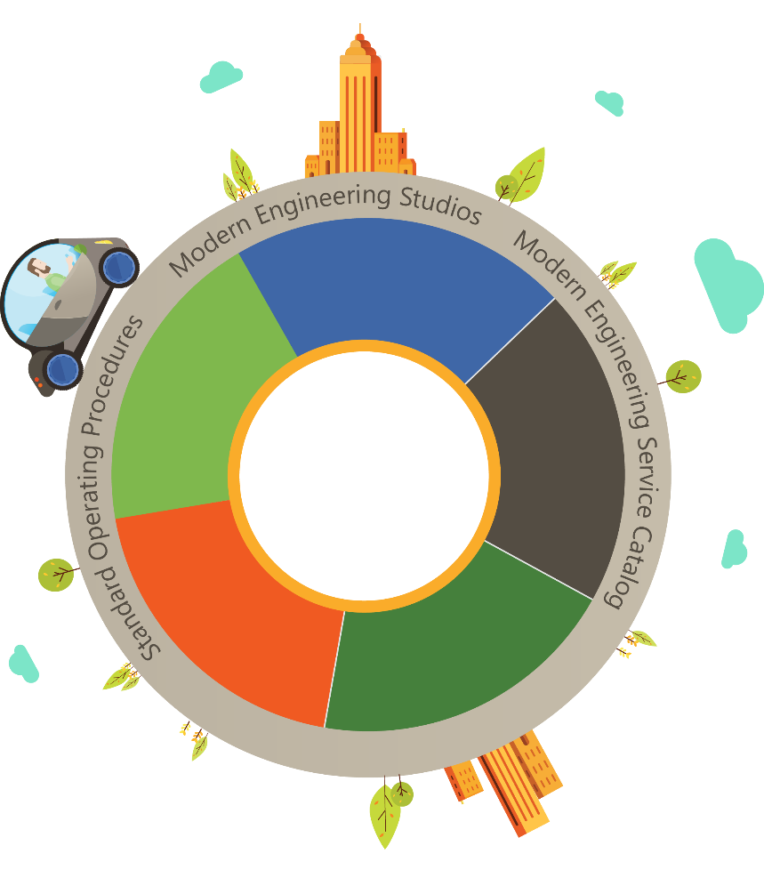
DevOps
People
Process
Tools
DevOps
Automation
AMEP (Avanade Modern Engineering Platform)
Service
Analytics
Modern
Engineering
Platform
Testing
& QA
Service
Management
Systems
Monitoring

Slide 15

What is Modern Engineering
Modern Engineering is a way to deliver IT services applying state-of-the-art principles and approach to deliver value with the pace of the business and drive rotation towards new. Modern Engineering helps organizations to look beyond traditional software application development process and respond quickly to changing business needs to sustain continuous delivery of new functionality for vital business initiatives at a lower cost
Traditional Engineering
Modern Engineering
IT Centric
Culture
Business Centric
Waterfall, V-Model
Approach
Agile, Iterative
Approval-based
Governance
Process-based
Manual
Effort
Automated
Process Efficiency
Value
Customer Experience/Outcome

Slide 16
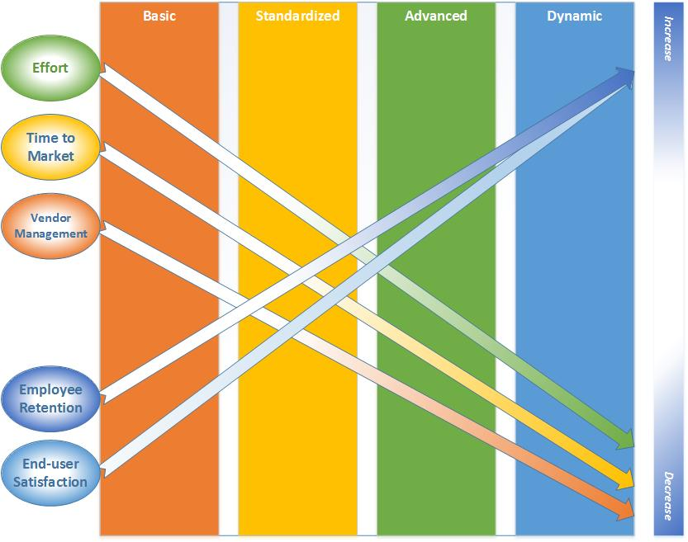
Modern Engineering – Maturity Model
Implementation of maturity model over time, affects many aspects of the client’s concerns and issues

Slide 17
Components of our Modern Engineering Platform
DevOps Automation
Use your resources more efficiently while getting the most out of continuous feedback and collaboration
Testing and QA
Automating testing and QA assures faster delivery of higher quality product
DevOps
Automation
Systems Monitoring
Stay on top of your systems for better response times and quicker institutional learning
Service
Analytics
Service Management
Simplify IT support across the board and resolve issues before they turn into problems
Modern
Engineering
Platform
Testing
& QA
Service Analytics
Better data means better results -- and support that improves over time
Service
Management
Systems
Monitoring

Slide 18

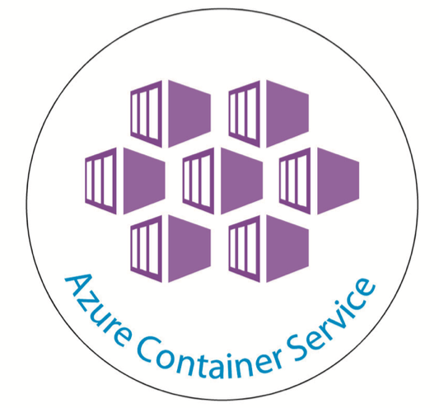


DevOps Tools and Assets to Drive Efficiency and Innovation
Scrum Management | Development | Testing & Quality | Source Code Management | Continuous Integration | Application Deployment | Application Monitoring, System Monitoring, Alerting | Environment Provisioning | Environment Maintenance | Service Management | Security System | Service Analytics Dashboards
Avanade DevOps
Visual Studio Team Services (VSTS), Visual Studio Team Foundation Server (TFS) | Visual Studio Team Services (VSTS), Visual Studio Team Foundation Server (TFS) | Visual Studio Team Services (VSTS), Visual Studio Team Foundation Server (TFS) Test Manager, SonarQube, Selenium | Visual Studio Team Services (VSTS) (supporting Git protocol) Visual Studio Team Foundation Server (TFS) | Visual Studio Team Services (VSTS) Visual Studio Team Foundation Server (TFS) Octopus | Visual Studio Team Services (VSTS), Visual Studio Team Foundation Server (TFS) PowerShell, Nuget | AppDynamics, Microsoft Application Insight, Azure Diagnostics, AMP Monitoring | Azure Resource Management (ARM), Visual Studio Team Services (VSTS), PowerShell DSC, Azure Automation | Azure Container Service, Docker, PowerShell, PowerShell DSC | ServiceNow | Microsoft Security tooling, Active Directory, GPO, Microsoft virus protection, Azure Security Groups, Azure-Watch | Microsoft Analytics Products, Azure Luis
AMP

Slide 19
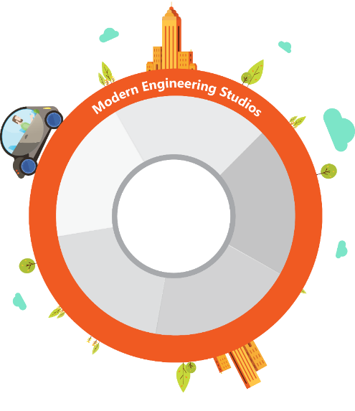
MEP Platform, offering & services
AMEP platform is designed to provide foundation layer to build enterprise DevOps framework leveraging pre-packed set of configuration and extensions (AMEP Cartridges) using Microsoft Ecosystems.
An AMEP cartridge will apply a configuration to one or more of the five AMEP components​ to enable DevOps methodology for the technology enabled by the cartridge
These cartridges are designed leveraging advanced technologies – Azure services, ARM, PowerShell, DSC etc.
Cartridges & Service Catalogue helps to build uniform DevOps framework. This includes:
Security Compliant VSTS Auto Provisioning (DevOps Automation)
Consistent Environment Auto Provisioning In Cloud in shorter time (DevOps Automation)
​Auto configuring CICD standard pipelines from templates (DevOps Automation)
Azure AD integrated SonarQube Auto Provisioning (Testing & QA)
Shared Instance ServiceNow Provisioning (Service Management)
Automatically tying prior incident resolutions to new incidents via machine learning and natural language recognition technologies (Service Management)
​The Modern Engineering Studio can provide expert services for mobilization, customization and support of the MEP toolset
DevOps
Automation
Service
Analytics
Avanade
Modern
Engineering
Platform
Testing
& QA
Service
Management
Systems
Monitoring
MEP Differentiators:
MEP Advisory
MEP Platform & Cartridges
MEP Standard/Fixed Price Services
MEP Studio

Slide 20
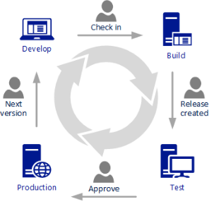
DevOps
People
Process
Tools
DevOps Development Approach

Slide 21











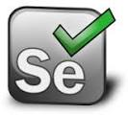


Build and Deployment Automation
Dev Team Checks-In Application code, unit test cases, selenium test cases etc. in the visual studio solution.
Dev Team
Build
Team Services Build is triggered with
each code change.
All Unit tests are executed. Any failure rejects the build and the check-In(Gated Check-Ins)
SonarQube Analysis is performed on the latest code and results are pushed to the Sonar server.
Code is packaged and readied for deployment by Team Services Release.
Ops Team Checks-In Infrastructure code(ARM Templates, PowerShell DSC Modules, Scripts etc.) in the same visual studio solution.
Ops Team
[Optional] Manual testing cycle
Deployment to higher environments
Release
[Optional] Approval workflows to deploy to higher environments
Functional tests(Selenium) are performed on the deployed code.
Application is deployed to the newly provisioned infrastructure.
Environment verification tests are performed.
Infrastructure is provisioned in the Azure Cloud.
ARM templates are triggered to create required infrastructure for the application.

Slide 22
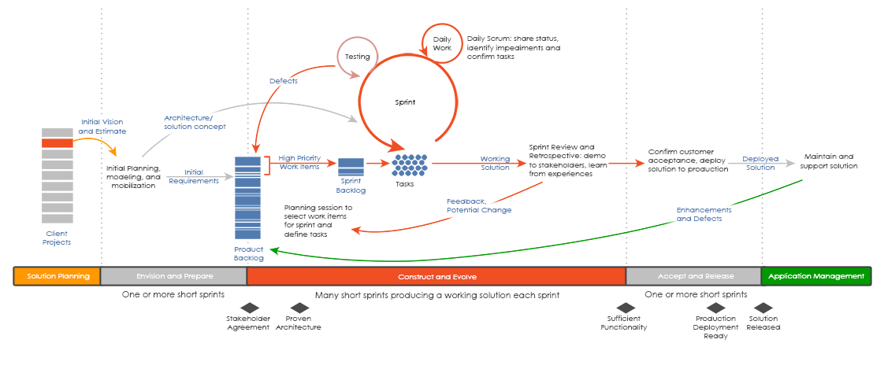
Avanade Agile Development Approach

Slide 23

Capability

Slide 24
Capability
Activities Overview
People
Tools & Accelerators
Process Assessment
Implementation Guidance
Process Consultation
Tools Guidance, Boot Camps
Microsoft Certified DevOps Professionals
SCRUM Certified Professionals
More than 500 Hrs. of DevOps implementation on multiple engagements
AppDev and Azure Architect
IS Architect *
Assessment Questionnaire & Maturity Worksheet
DevOps Tool Guidance Microsoft Ecosystem
DevOps Management Portal
DevOps Process Workflow
Ops Friendly Frameworks
Telemetry Guidance
* IS Architect to be engaged from IS Team

Slide 25
Credentials

Slide 26
Client Overview and Accenture Proposition Overview
The client is a research-focused healthcare company that discovers, develops and provides innovative diagnostics and therapeutic products and services that deliver significant benefits to patients and healthcare professionals from early detection and prevention of diseases to diagnosis, treatment and treatment monitoring.
Accenture/Avanade is involved in development and maintenance of software for instruments (blood screening in-vitro diagnostics machines) in the following areas: Architecture, Requirements Management, Development, Testing, Continuous Integration, Instrument testing, PMO, Reporting and Documentation.
In 2016, project will expand the scope to cover additional areas: Scope and Design, Continuous Integration – extension of shared services to additional projects, Functional Testing and Pre-SI (System Integration) testing.

Slide 27
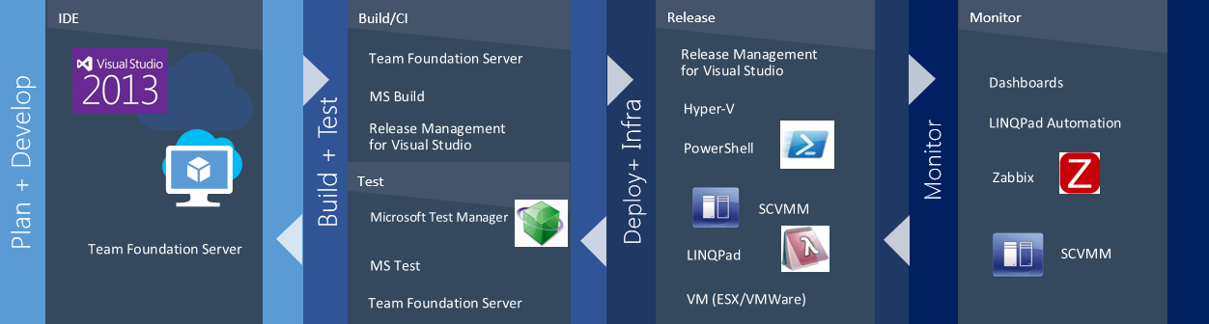
Continuous Integration Overview
The Continuous Integration provides guidelines for process executed by the development teams, using the Client’s DevOps practices that includes:
Software Configuration Management - Automated build processes
Software installation routines - Software release notes
Virtual test environments and - Gathering / Reporting of numerous metrics.
Instrument Test
Manual Application Integration Tests
Software Development / Maintenance
Compilation of Source Code
Execution of Dev & Unit Tests
Deployment to Virtual Test Environments
Automated Application Integrated Tests

Slide 28
Journey through Key Challenges
Early 2013
A nightly Build produced once every few days
Process for execution of Sanity Tests was un-documented with each execution taking ½ day or more.
Early 2014
Began developing detailed Build Reporting Automation producing build summaries resulting in error-free high quality repetitive tasks outputs
Early 2016
Early 2015
Achieved ~100% Pass Rate for the failing 11,000 Unit tests
Successful execution of 500,000 Unit Tests every day
Implemented high turn-around improvements with 95% uptime for Hyper-Vs & 99% for ESX VM per quarter
Completely automated CI process setup for new project.
All CI Service Requests received through CI Shared Mailbox.
Successful implementation of the enhanced build process across two key large projects.
Late 2013
Constant un-tested & un-controlled check-ins broke the branch code sanity often in a single day resulted in huge investigation tasks till rollbacks were done.
Late 2015
Create concept of Automatic build downloads from Europe Data Center
Late 2016 & beyond
Development and execution of TFS 2015 UAT
Creation Continuous Integration Manuals documented how Service tasks are handled created.
Late 2014
Over 11,000 Unit Tests failing in every build
Usage of a Heterogeneous TFS, Build & Virtual lab environment resulted in high dependency on the Client IT during Outages
Additional ramp of Build and Virtual Lab Environment dashboards through Automation achieved
Continue to enhance Automation and Documentation
Migration to TFS 2013
Implementation of additional enhancements to the new build process
Enhanced Automation and Documentation

Slide 29
Thank You

